Slide 2




PRAISE-U Vision
Every man in the EU needs to be aware of the pros and cons of early detection for PCa.
EU member states should be able to offer high quality clinical standards including state-of-the-art individualized approaches to achieve timely PCa detection in men who can benefit from early treatment.
With increasing knowledge, awareness of the need for the early detection of significant PCa, as well as societal and patient-empowerment, we envision this algorithm of testing will ensure harmonization and cost-effective implementation across EU member states in order to achieve the highest decrease in mortality, while avoiding opportunistic testing, overdiagnosis and overtreatment.
In addition to a decrease in disease specific mortality, this will decrease the incidence and burden of metastatic disease, and at the same time maintain and increase quality of life (QoL) of patients and their families, thereby resulting in improved prognosis of men diagnosed with PCa in the future.

Slide 3


PRAISE-U Mission
Get insights and assess needs in EU member states to design a diagnostic strategy and algorithm for EU Prostate Cancer Screening that is cost-effective and be able to raise awareness of PCa and its implications.
EU member states tailored recommendations on screening strategies will be based on available knowledge on specific risk groups, a multi-step risk-based early detection strategy including individualized interval for PSA testing combined with risk calculators and imaging modalities, such as multiparametric magnetic resonance imaging (mpMRI).
This will allow for an approach avoiding unnecessary (repeated) testing, overdiagnosis, and consequently reducing overtreatment as well as the number of men diagnosed with metastatic disease and mortality.

Slide 4
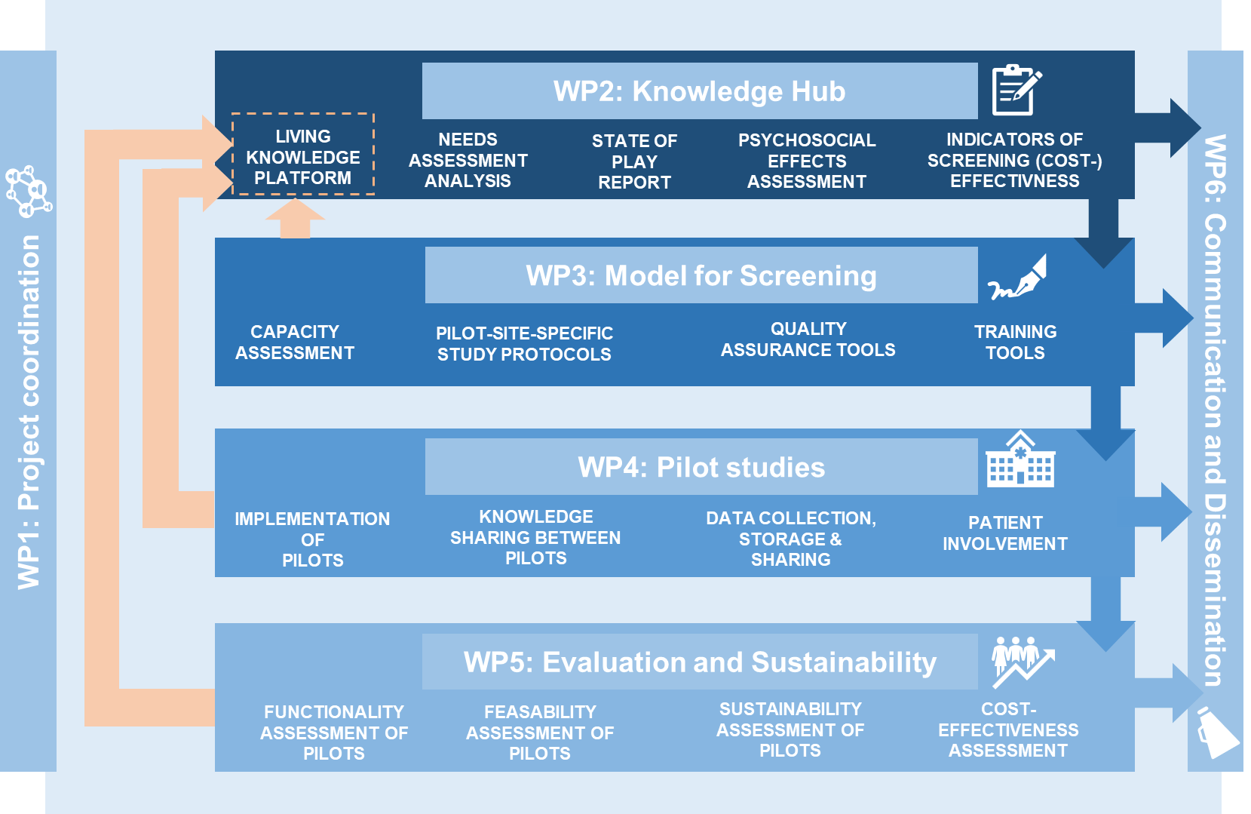
Work Packages
Year 1:
In all 27 EU member states:
needs assessment and
state of play
Year 2:
In 5 sites: pilot-site specific
study protocols
Year 3:
Detailed evaluation.
-> Living knowledge platform on PCa screening

Slide 5























Consortium of 25 institutions from 12 Member States
BENEFICIARIES
ASSOCIATED PARTNERS

Slide 6
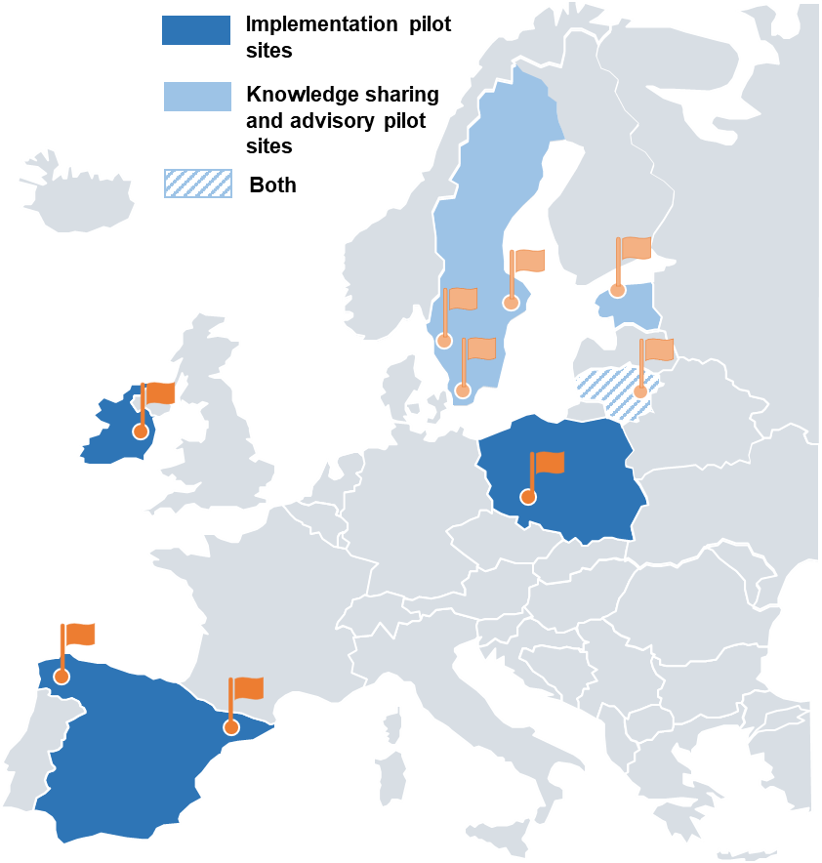

Slide 7
Launch: April 2023 Duration: 3 years

Slide 8
Project Deliverables
WP1 | D1 | Project management plans | 31 May 2023
WP1 | D2 | Quality assurance and risk mitigation plan | 30 Sep 2023
WP2 | D3 | Needs assessment report | 30 Nov 2023
WP2 | D4 | Living document on harm/benefit and cost effectiveness | 30 Nov 2023
WP2 | D5 | Key Performance Indicators for PCa screening effectiveness | 31 Mar 2024
WP3 | D6 | Capacity Assessment Report including current standard of care | 31 Dec 2023
WP3 | D7 | Framework or protocol for implementation of PCa screening programme | 31 Mar 2024
WP3 | D8 | Readiness and capacity assessment for sustainability and scaling report | 31 Mar 2026
WP4 | D9 | Pilot local implementation plan (including ethical approval and data sharing agreements) | 31 May 2024
WP4 | D10 | Pilot final report | 30 Sep 2025
WP5 | D11 | Report on identification and participation, risk stratification for biopsy, biopsy rates, and cancer detection and opportunistic testing | 31 Dec 2025
WP5 | D12 | Report on psychosocial aspects | 31 Mar 2026
WP5 | D13 | Costs analysis | 31 Mar 2026
WP6 | D14 | PRAISE-U dissemination and communication strategy | 31 Aug 2023
WP6 | D15 | Final report on PRAISE-U dissemination and communication strategy | 31 Mar 2026

